Slide 1
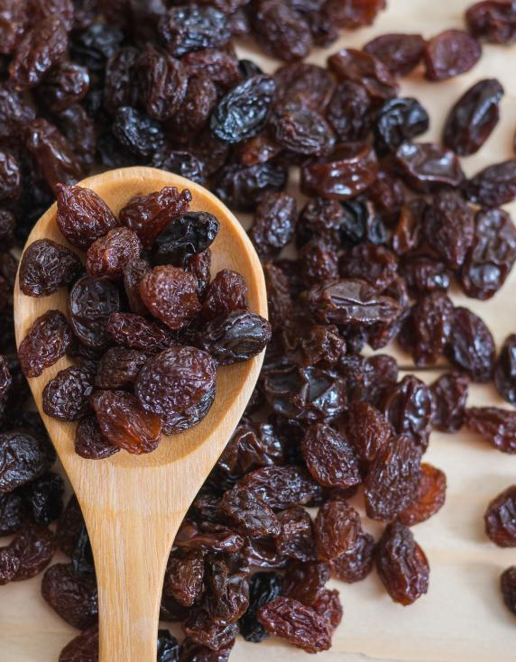
RAISIN CLASSIFICATION

Slide 2
EXPLORATORY DATA ANALYSIS
1
2
3
4
5
CHECKING DATATYPE AND MISSING VALUES
OUTLIER ANALYSIS
CORRELATION
ANALYSIS
STANDARDIZATION/
NORMALIZATION
FUTURE ENGINEERING

Slide 3
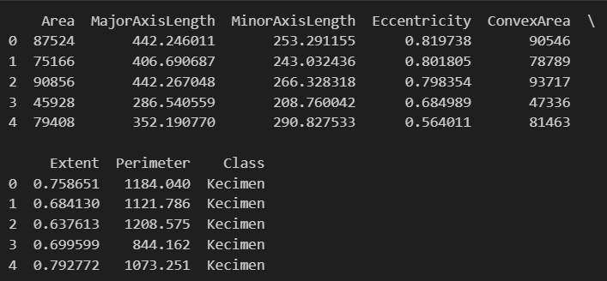
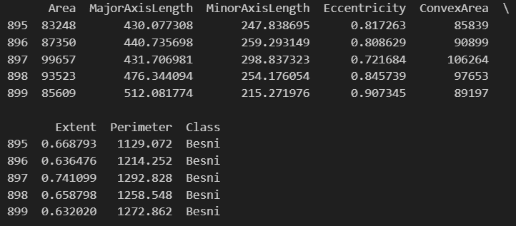
DISPLAYING & UNDERSTANDING THE DATASET
#READING THE DATASET
dp=pd.read_csv("C:\project\Raisin_Dataset.csv")
print(dp)
#CHECKING FIRST 5 DATAS
print(dp.head())
#CHECKING LAST 5 DATAS
print(dp.tail())
RAISIN DATASET CLASSIFICATION

Slide 4
OUTLIERS
Point that is significantly different from the other data points in a dataset.
METHOD USED IN DATA SET: IQR METHOD
The IQR method is a way to identify outliers in a data set.
It is based on the following steps:
1).Calculate the IQR by subtracting Q1 from Q3.
2).Identify any values that are less than Q1 - 1.5IQR or greater than Q3 + 1.5IQR. These values are considered to be outliers.
#FINDING OUTLIERS USING IQR METHOD
def outlier(df, ft):
df[ft] = pd.to_numeric(df[ft])
q1 = df[ft].quantile(0.25)
q3 = df[ft].quantile(0.75)
iqr = q3 - q1
outliers = df[ft][(df[ft]<q11.5*iqr)|(df[ft]>q3+1.5 * iqr)]
return list(outliers.index)
NOTE : IN RAISIN DATASET, ALL THE COLUMN CONTAINS OUTLIERS EXCEPT THE CLASS COLUMN

Slide 5
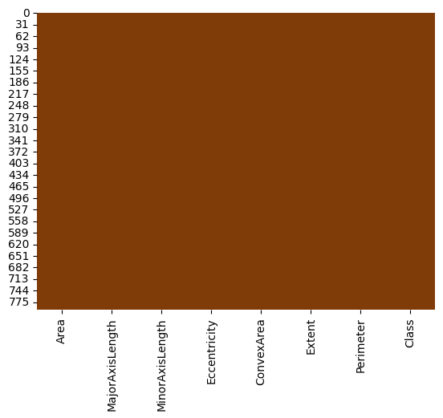
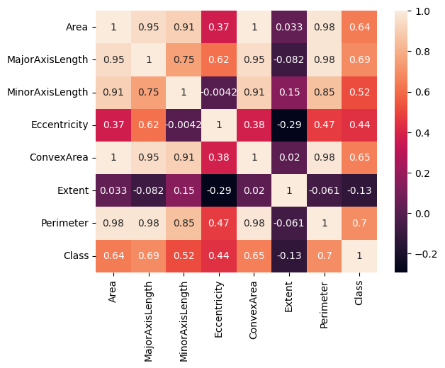
CORRELATION MATRIX
VISUALLY CHECK FOR MISSING VALUES

Slide 6
RANDOM FOREST ALGORITHM
 | PRECISION | RECALL | F1 SCORE | SUPPORT
0 | 0.83 | 0.87 | 0.85 | 124
1 | 0.85 | 0.81 | 0.83 | 115
accuracy |  |  | 0.84 | 239
macro avg | 0.84 | 0.84 | 0.84 | 239
weighted avg | 0.84 | 0.84 | 0.84 | 239

Slide 7
SUPPORT VECTOR MACHINE ALGORITHM
 | PRECISION | RECALL | F1 SCORE | SUPPORT
0 | 0.81 | 0.95 | 0.87 | 76
1 | 0.94 | 0.80 | 0.86 | 83
accuracy |  |  | 0.87 | 159
macro avg | 0.88 | 0.87 | 0.87 | 159
weighted avg | 0.88 | 0.87 | 0.87 | 159

